Slide 1
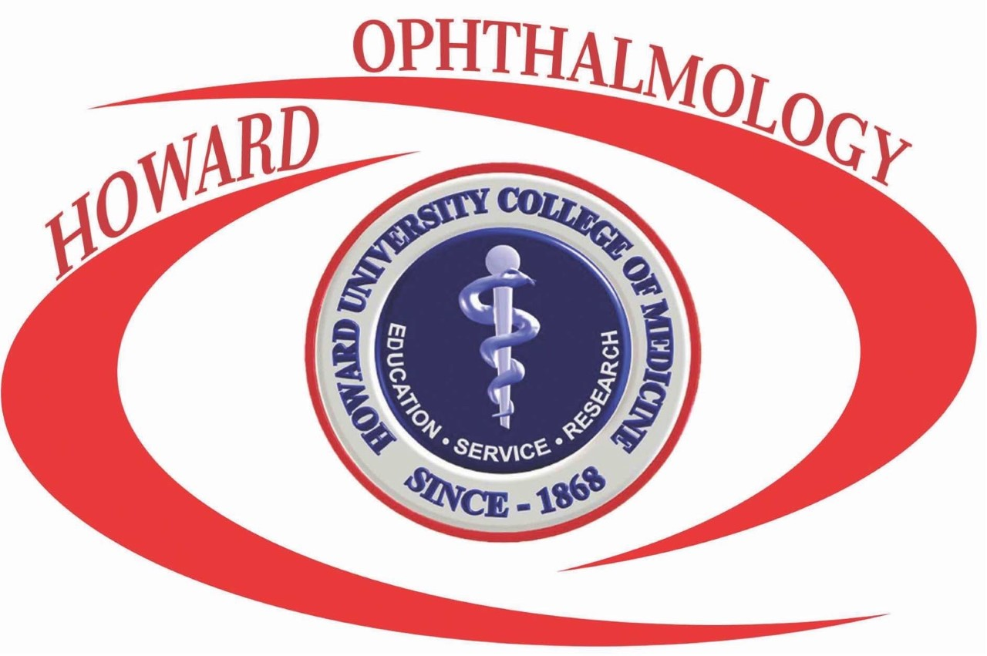
Welcome Applicants

Slide 2
History of Program
Long history of promoting diversity and supporting underrepresented groups
  Dr. Isabelle C. Barrows, described as the first American female ophthalmologist, was an early teacher of diseases of the eye at the College of Medicine, from 1870 to 1873
  Dr. Pearl A. Watson was the first resident in ophthalmology to complete her training at Howard University and Freedmen’s Hospital and become a diplomat of the American Board of Ophthalmology
  Today, the only ophthalmology residency program associated with an HBCU medical school

Slide 3
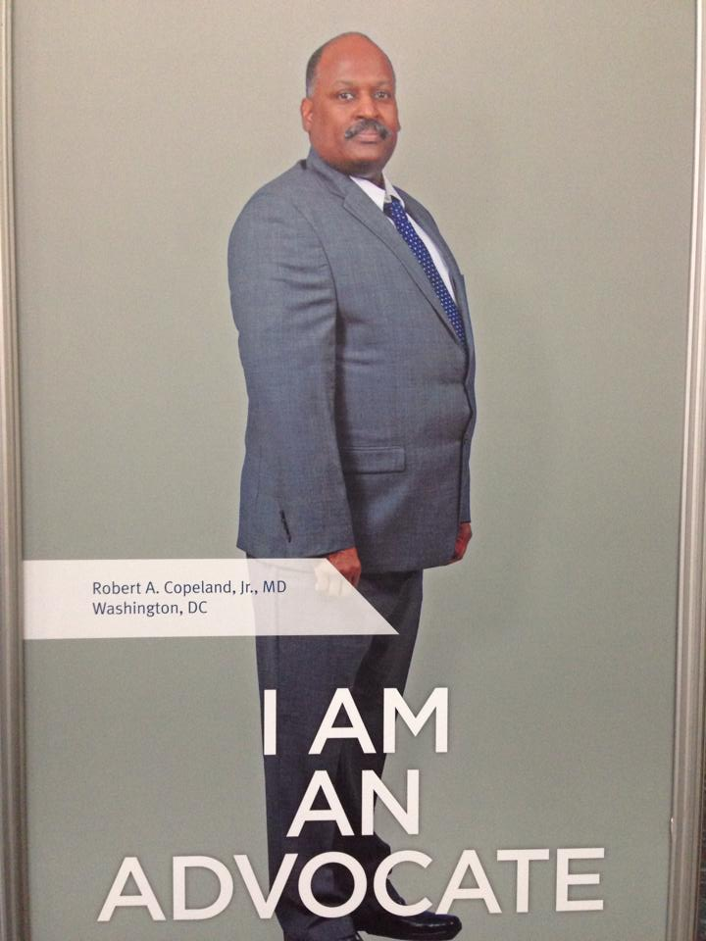
History of Program
Residency program first accredited in 1946
Dr. Robert Copeland, Jr. succeeded in elevating us to departmental status on January 22, 2000, a date we celebrate annually as Founders Day

Slide 4
Rotation Sites
Howard University Hospital (HUH)
  Prevention of Blindness Society
  Metropolitan Pediatric Ophthalmology
  Bethesda Neurology
  Refractive Surgery Center with Dr. Nasrullah
Washington DC VAMC
Orlando VA

Slide 5
Weekly Schedule at HUH Site
Clinic
Day | Monday | Tuesday | Wednesday | Thursday | Friday
AM | Cornea or Comprehensive | Pediatrics | Glaucoma | Plastics | Neuro-ophthalmology or Retina
PM | Cornea or Comprehensive | Retina | Glaucoma | Retina | Wet lab/ research/study
Surgery
Day | Monday | Tuesday | Wednesday | Thursday | Friday
 | Cataract (Dr. Elliott) | Glaucoma and Cataract (Dr. Jones) Cornea and Ant Segment (Dr. Bovelle) | Cataract and Anterior Segment (Dr. Chin Loy or Dr. Barnes) | Plastics (Dr. Kidwell) | Plastics (Dr. Kidwell) Pediatrics (Dr. Smith-Marshall) Refractive (Dr. Nasrullah)
Lecture
Day | Monday | Tuesday | Wednesday | Thursday | Friday
 | Cornea Atlas Rounds Oral Boards | Pediatrics | General | Plastics or Contact Lens | Neuro-ophthalmology
Didactics all day on 3rd Thursday of the month: Pathology, Glaucoma, Lens and Cataract, Retina, Invited Guests

Slide 6
Residency Program Structure
PGY-1
Ophthalmology (3 blocks)
PGY-2
Introductory Basic Clinical Science Course with Georgetown, George Washington and Walter Reed (1 month)
PGY-3
HUH – Daily subspecialty clinics and surgical exposure as assist and primary surgeon. Surgery in glaucoma, oculoplastics, pediatric/strabismus, cataract and anterior segment, including cornea and refractive surgery (4 months)
PGY-4
Orlando VA – General clinic, cataract and femtosecond laser surgery, laser clinic (8 months)
HUH all year round
Low Vision and Pediatrics Rotation – Prevention of Blindness Society, Metropolitan Pediatric Ophthalmology
Early surgical exposure as 1st assistant
Washington DC VA – Comprehensive clinic, cataract and plastic surgery, laser and injection clinic (4 months)
Inpatient (3 blocks): Wards (2 blocks) and MICU
Outpatient/Consult (7 months): Infectious Disease, Rheumatology, Neurology/Neuroradiology, Emergency Medicine, Anesthesia, ENT, Ambulatory medicine
Refractive Surgery Rotation
Participate in lectures, grand rounds and annual symposia at primary site
Children’s National Medical Center – Comprehensive pediatric and strabismus rotation (4 months)
HUH – Senior resident in clinic and the operating room, similar to PGY-3 but more primary cases and more complex cases (4 months)

Slide 7
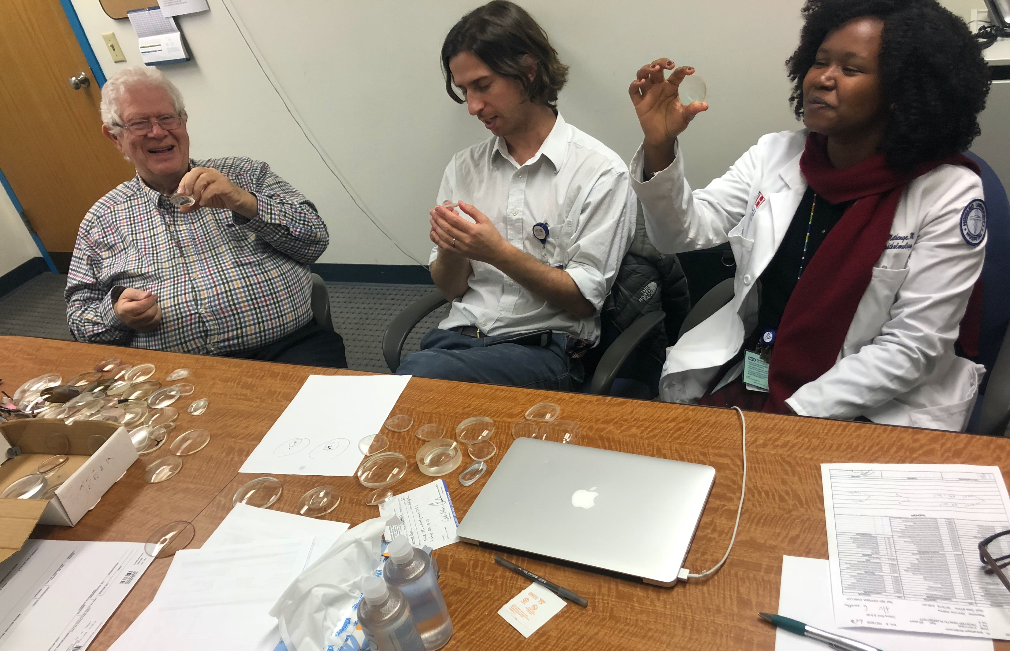
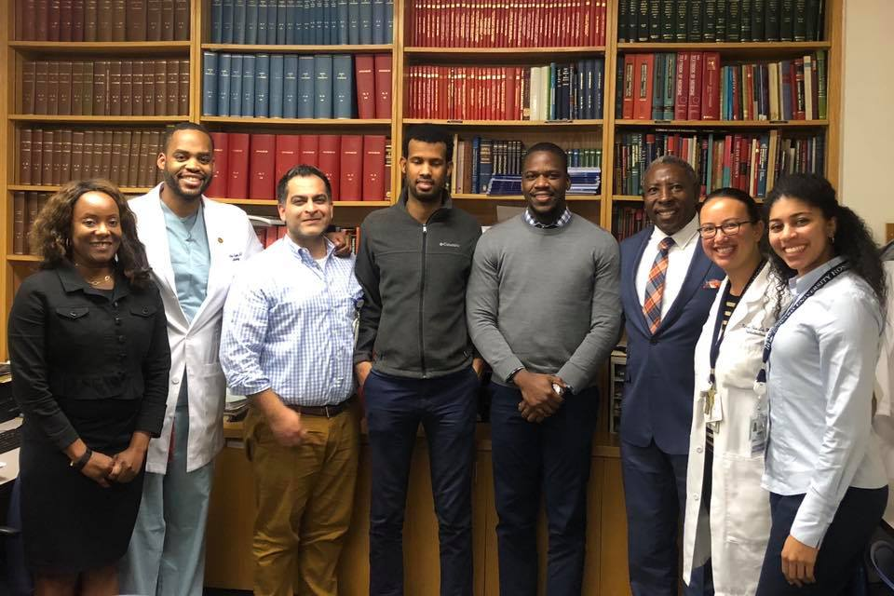
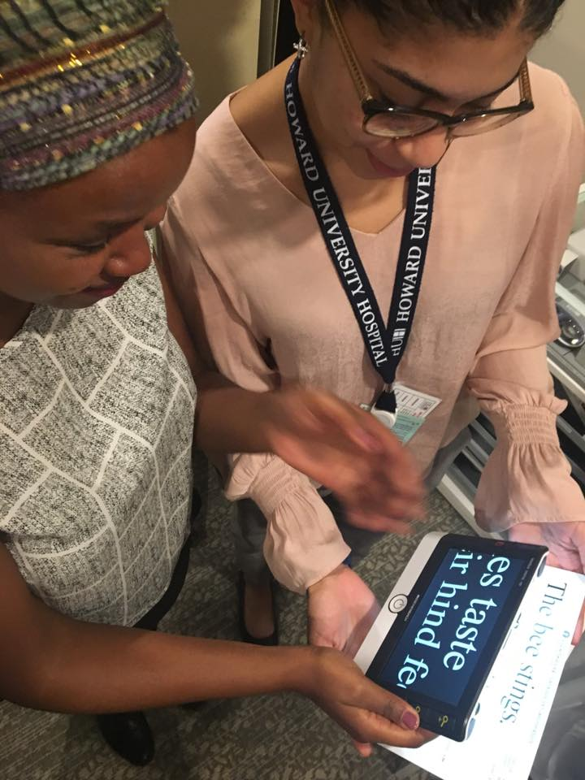
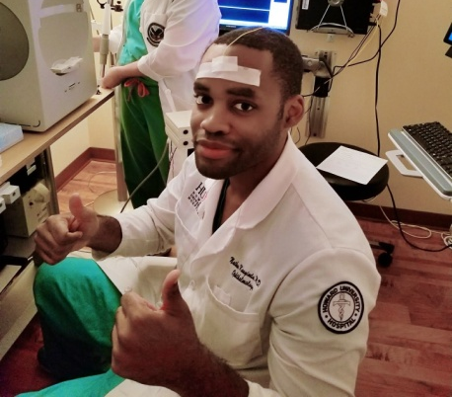
Educational Activities
  Didactics
    Subspecialty lectures daily before clinics
    Monthly core lectures (pathology, glaucoma, lens, retina)
    Weekly lectures by rotating attendings (Orlando)
    Quarterly Journal club and M&M (Orlando)
    Invited guest speakers

Slide 8
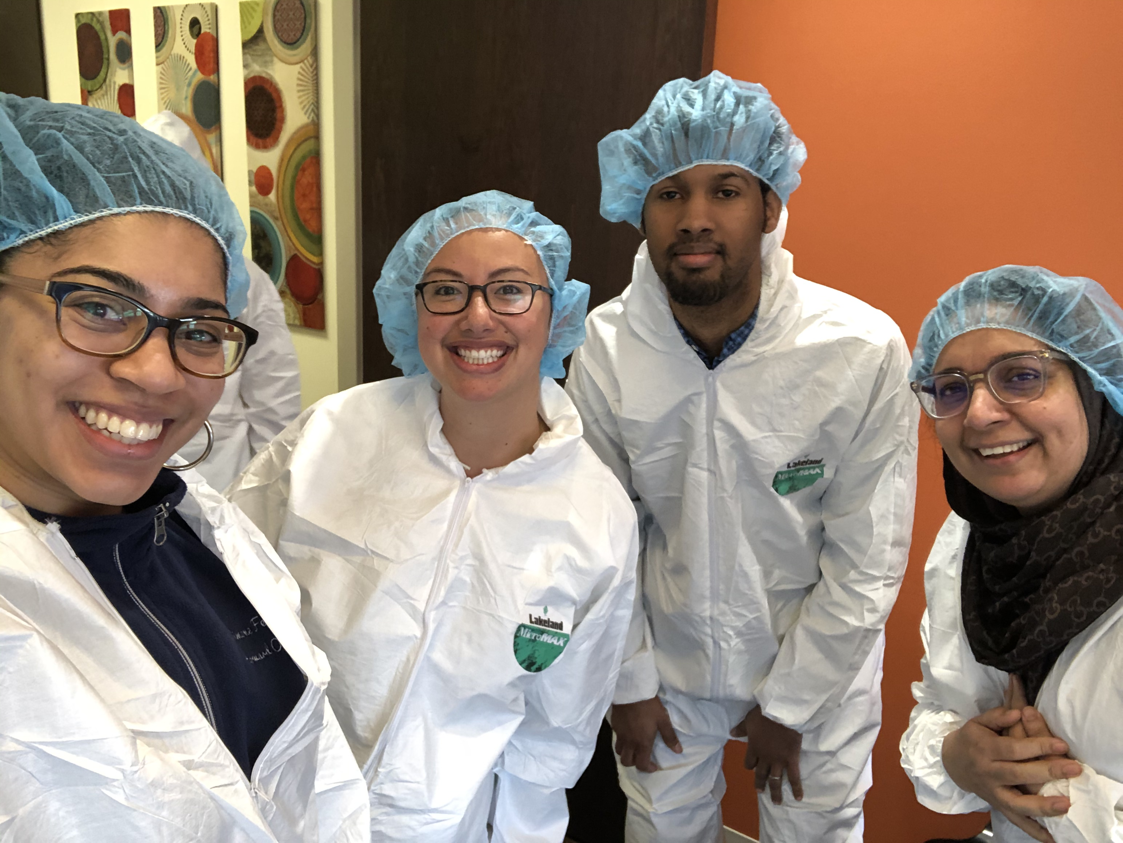
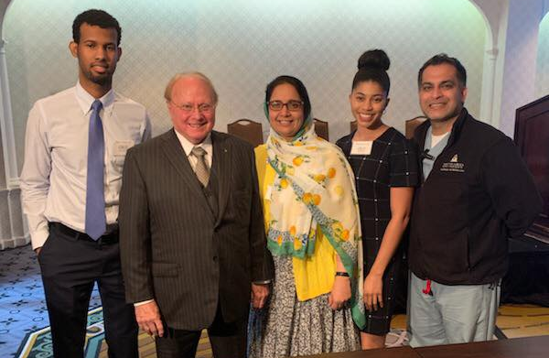
Educational Activities
Interinstitutional city-wide lecture series
  Introductory BCSC Course
  Monthly RGW FA conference and lecture
  Monthly CNMC journal club
  Annual Cherry Blossom Pathology Course
  Annual Ocular Trauma Course
  Wilmer Refractive Surgery Course
  Annual Low Vision Symposium
  Foster Ocular Inflammatory Disease Conference

Slide 9
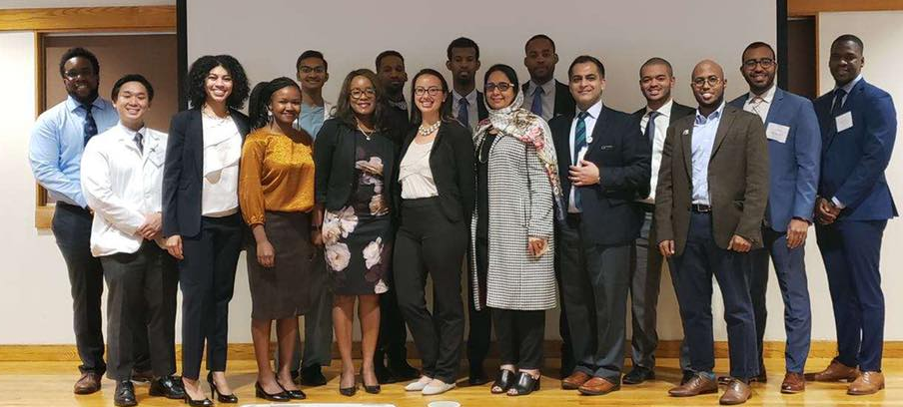
Educational Activities
Chief Rounds
  Question review
Annual Symposia
  Roger P. Mason, MD Glaucoma Day
  Lois A. Young, MD Clinical Day
Atlas and Board Rounds
  Review histology
  Practice Oral Boards cases
Grand Rounds
  Case presentations
  Journal club
  Morbidity and Mortality/QI
  Research updates

Slide 10
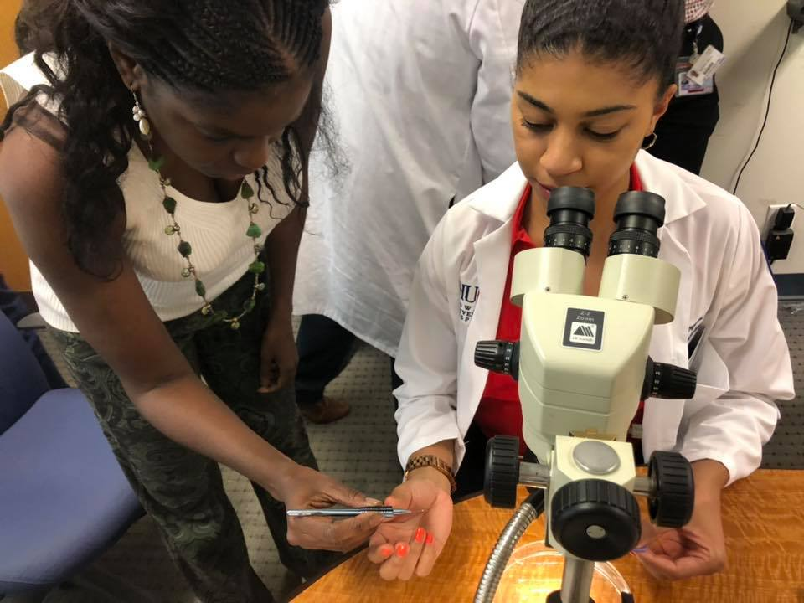
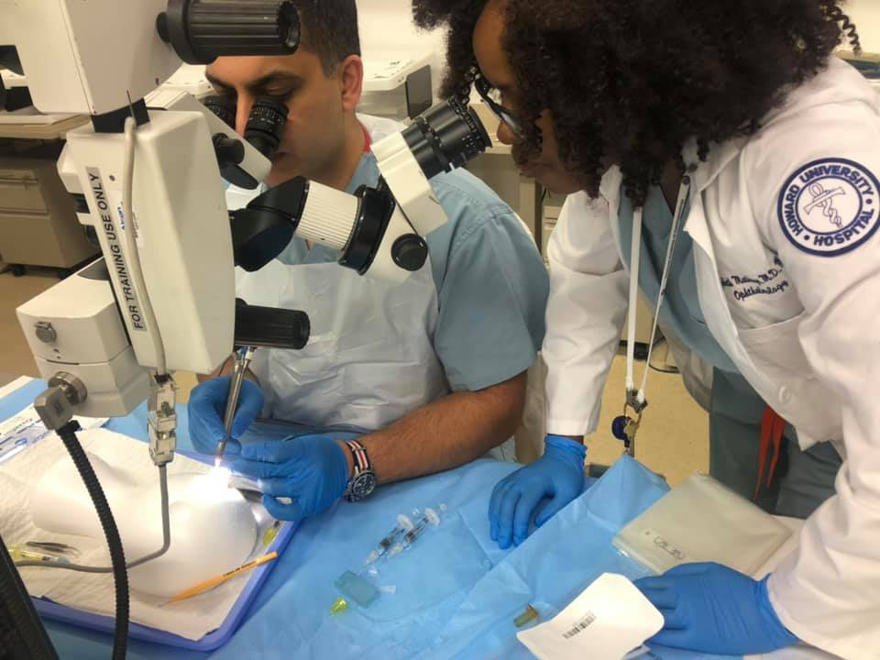
Educational Activities
Wet Labs
  Friday afternoon lab time
  Monthly skills training with industry partners
  At least 2 annual larger wet labs
  Access to EyeSi Surgical Simulator
  Seniors participate in AAO SCOR curriculum

Slide 11
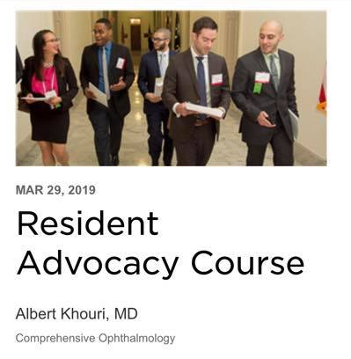
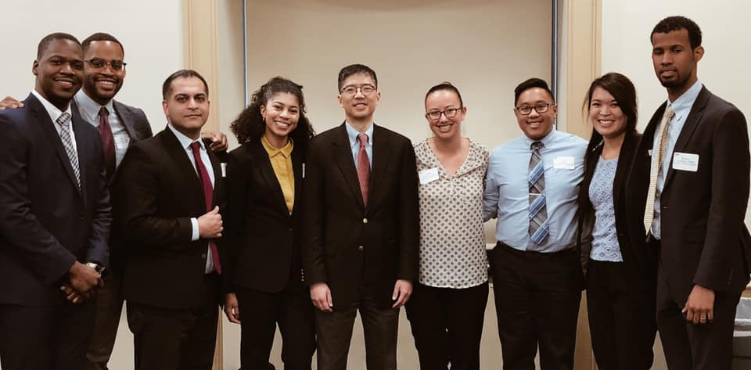
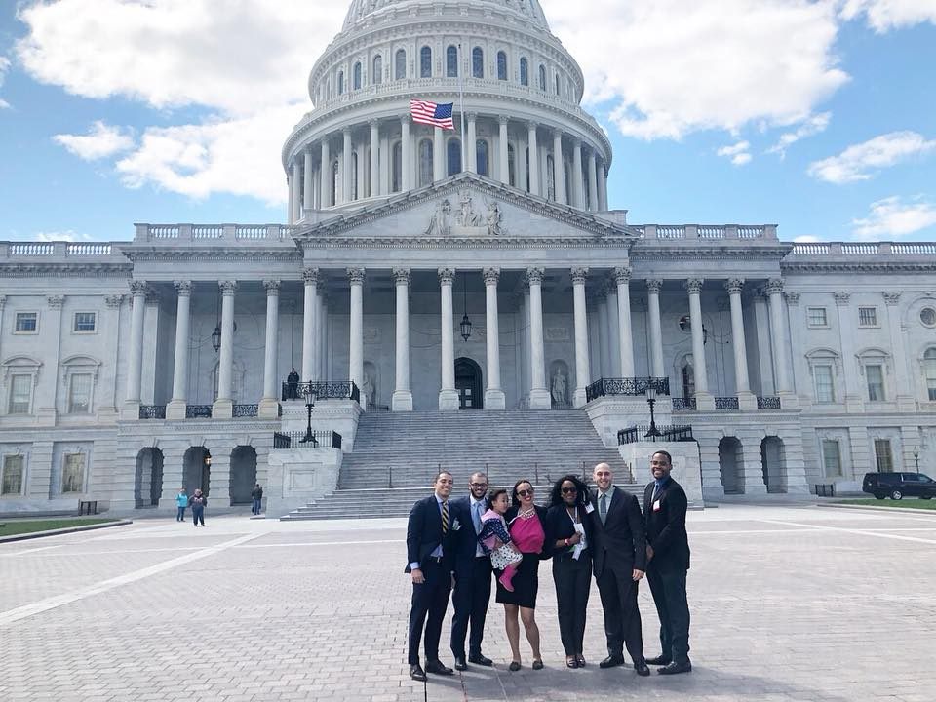
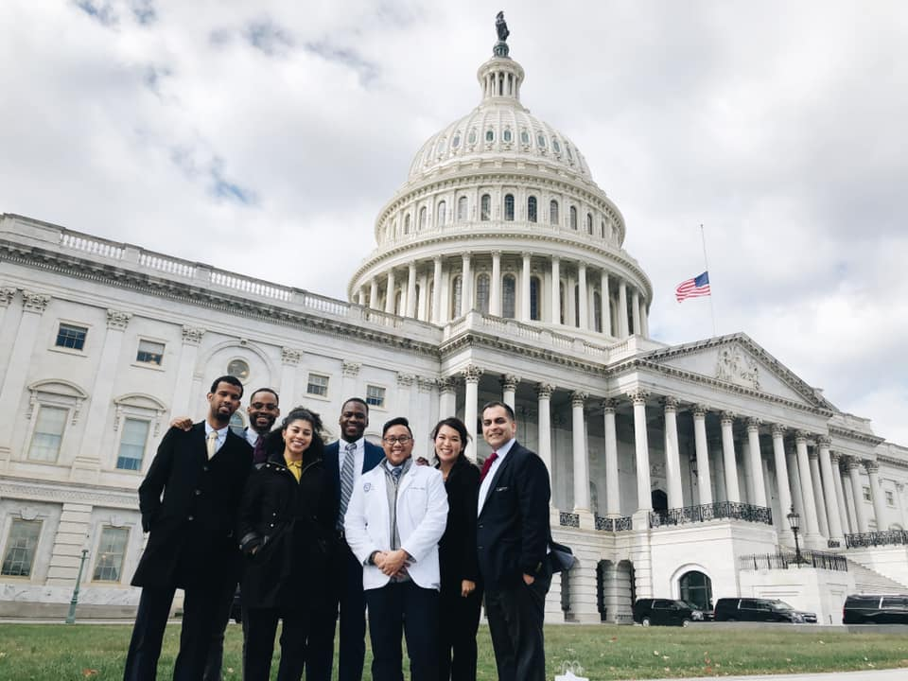
Educational Activities
Advocacy
  AAO Congressional Advocacy Day
  WDCMOS
  Proximity to Capitol Hill

Slide 12
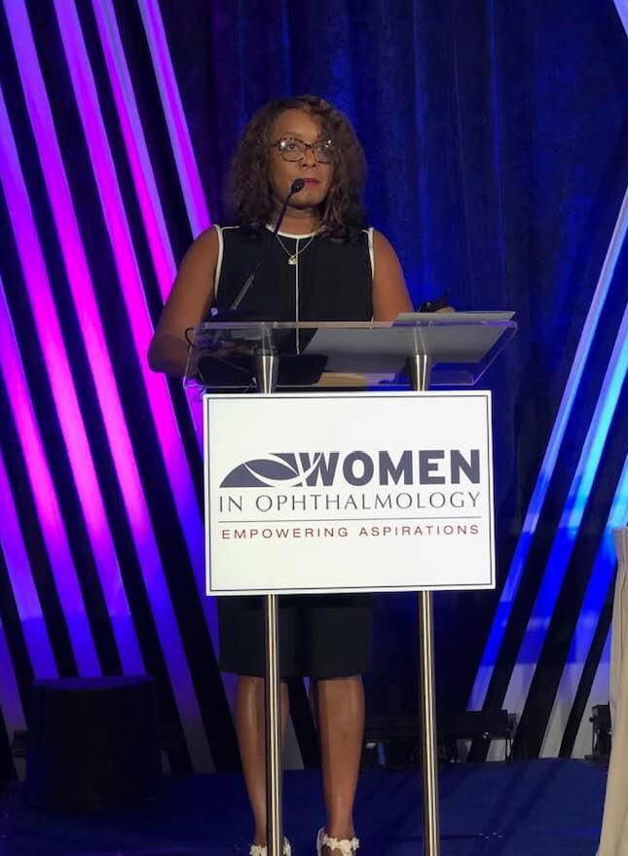
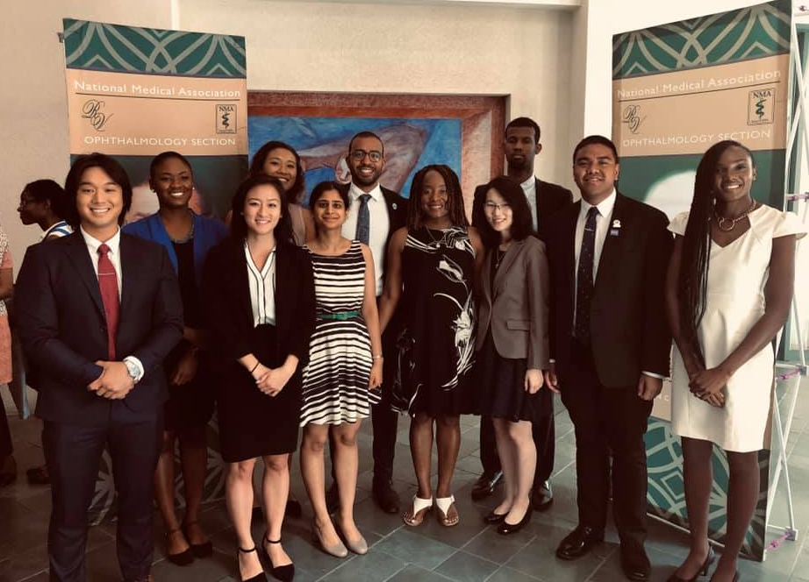
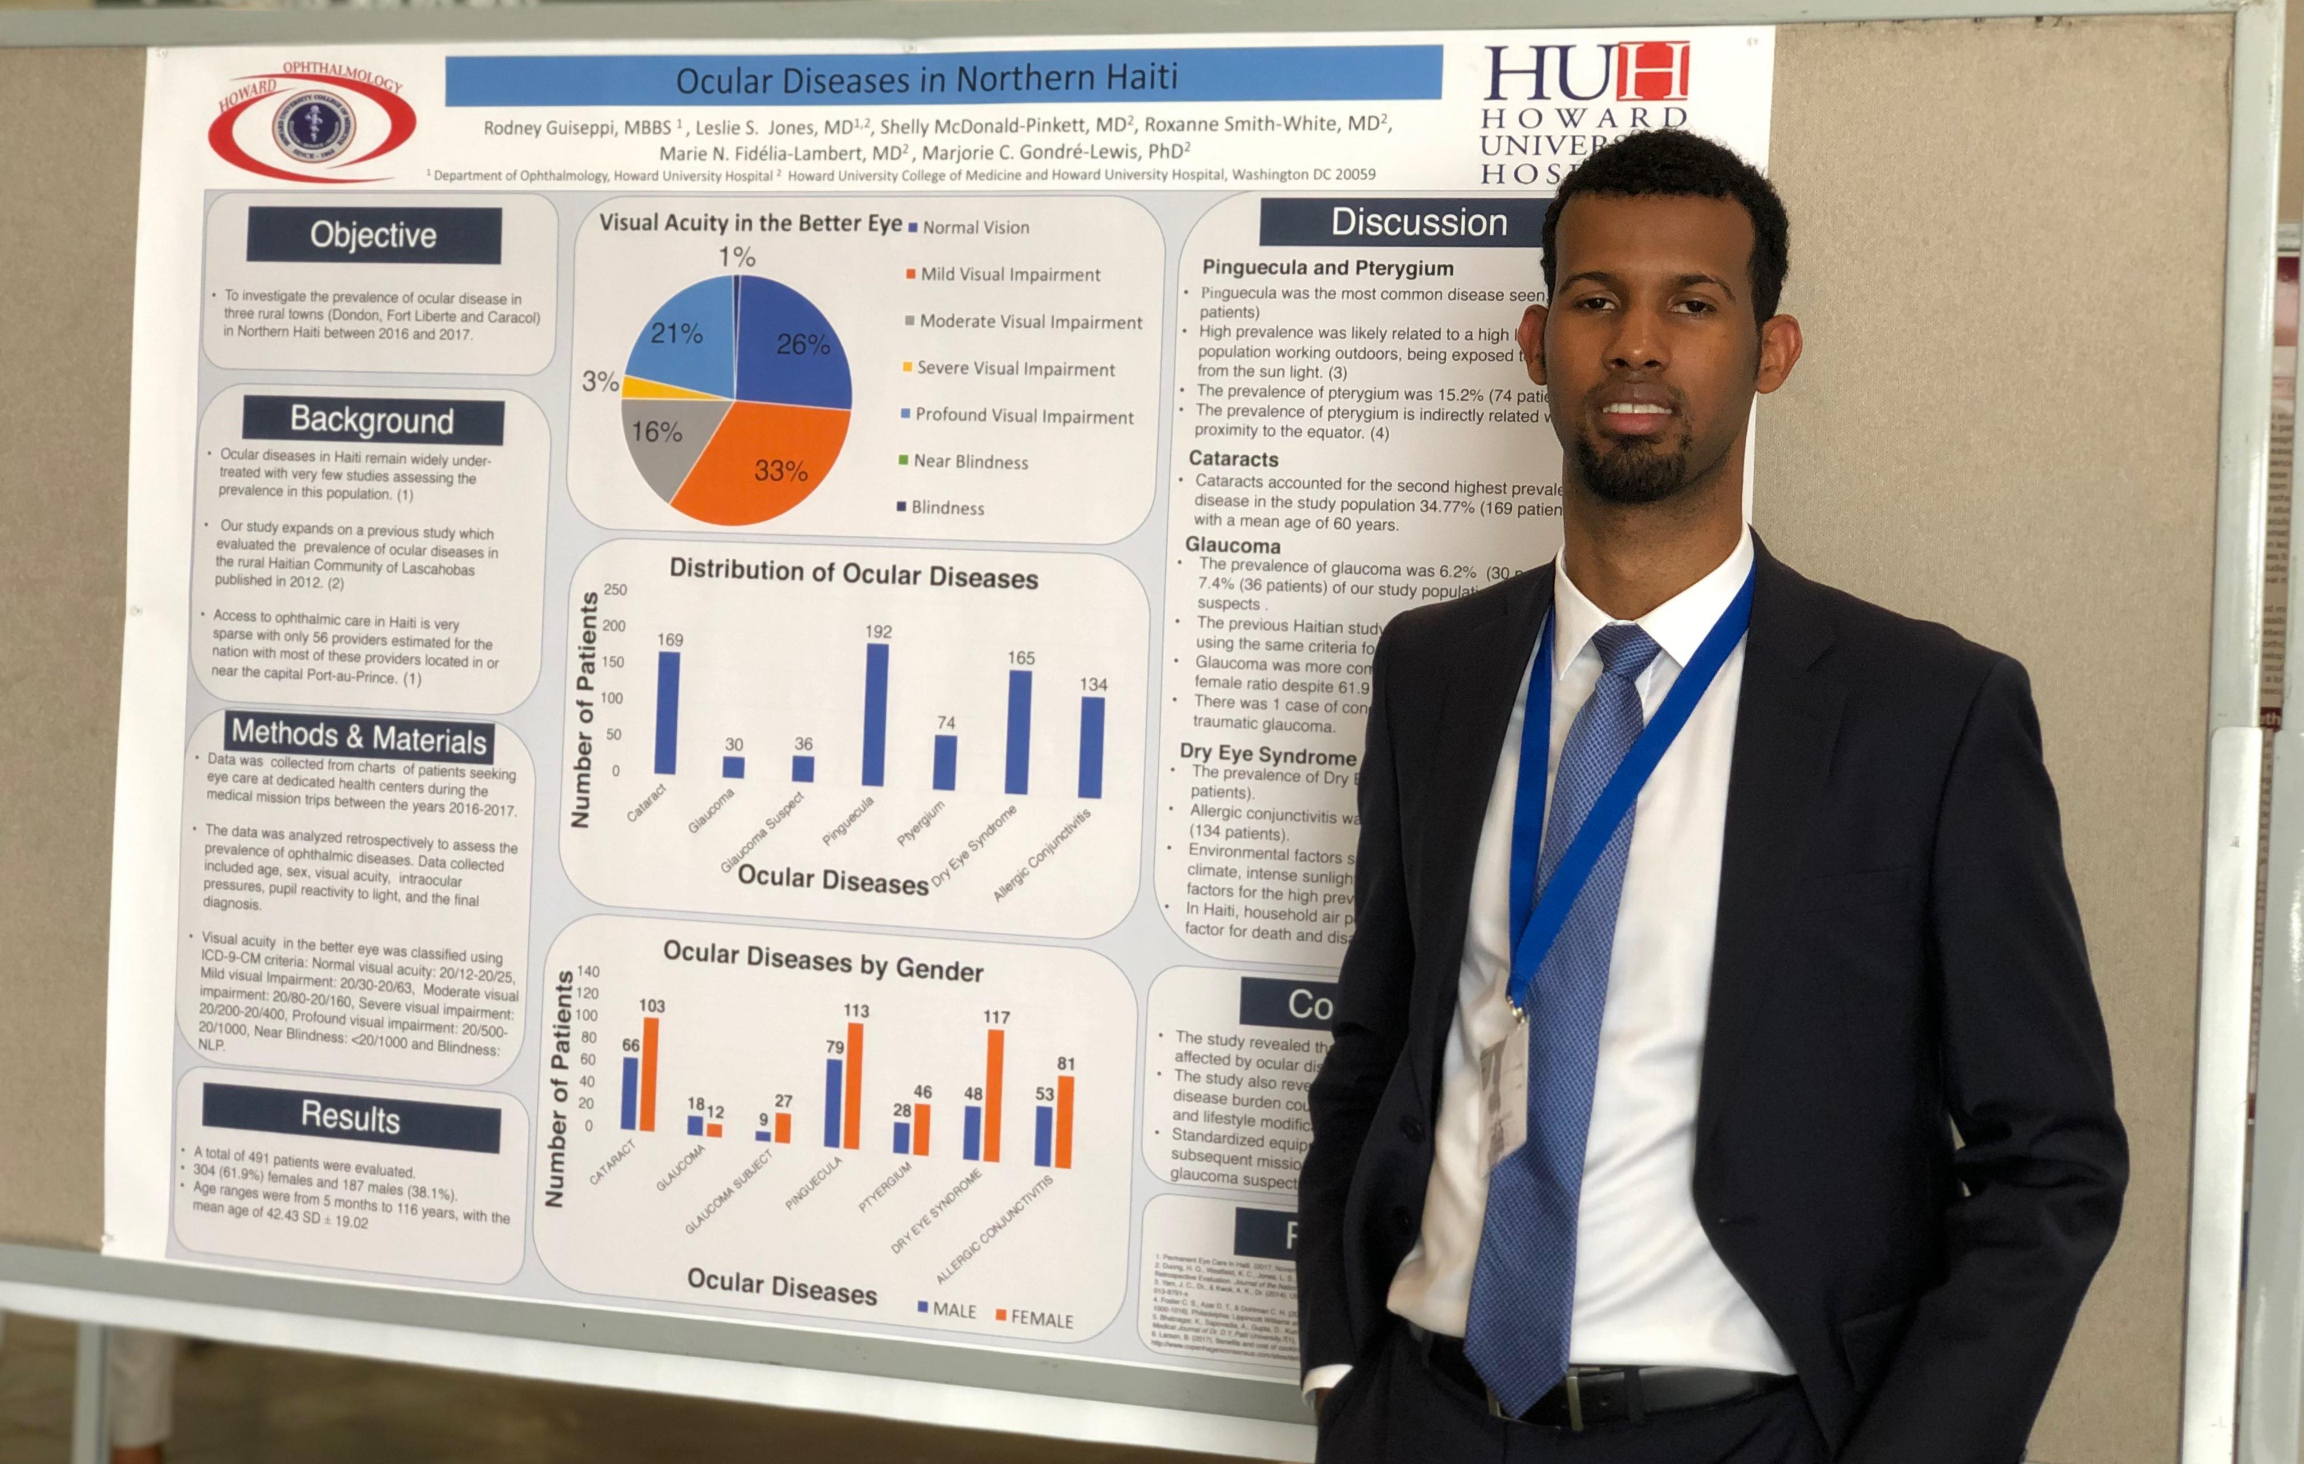
Educational Activities
National Conferences
  Residents and faculty are encouraged to submit to and present at national conferences
  GME reimburses the cost for travel and attendance at up to 2 conferences annually if the resident is the presenting author
  Senior residents are reimbursed for costs associated with participation in the AAO annual meeting

Slide 13

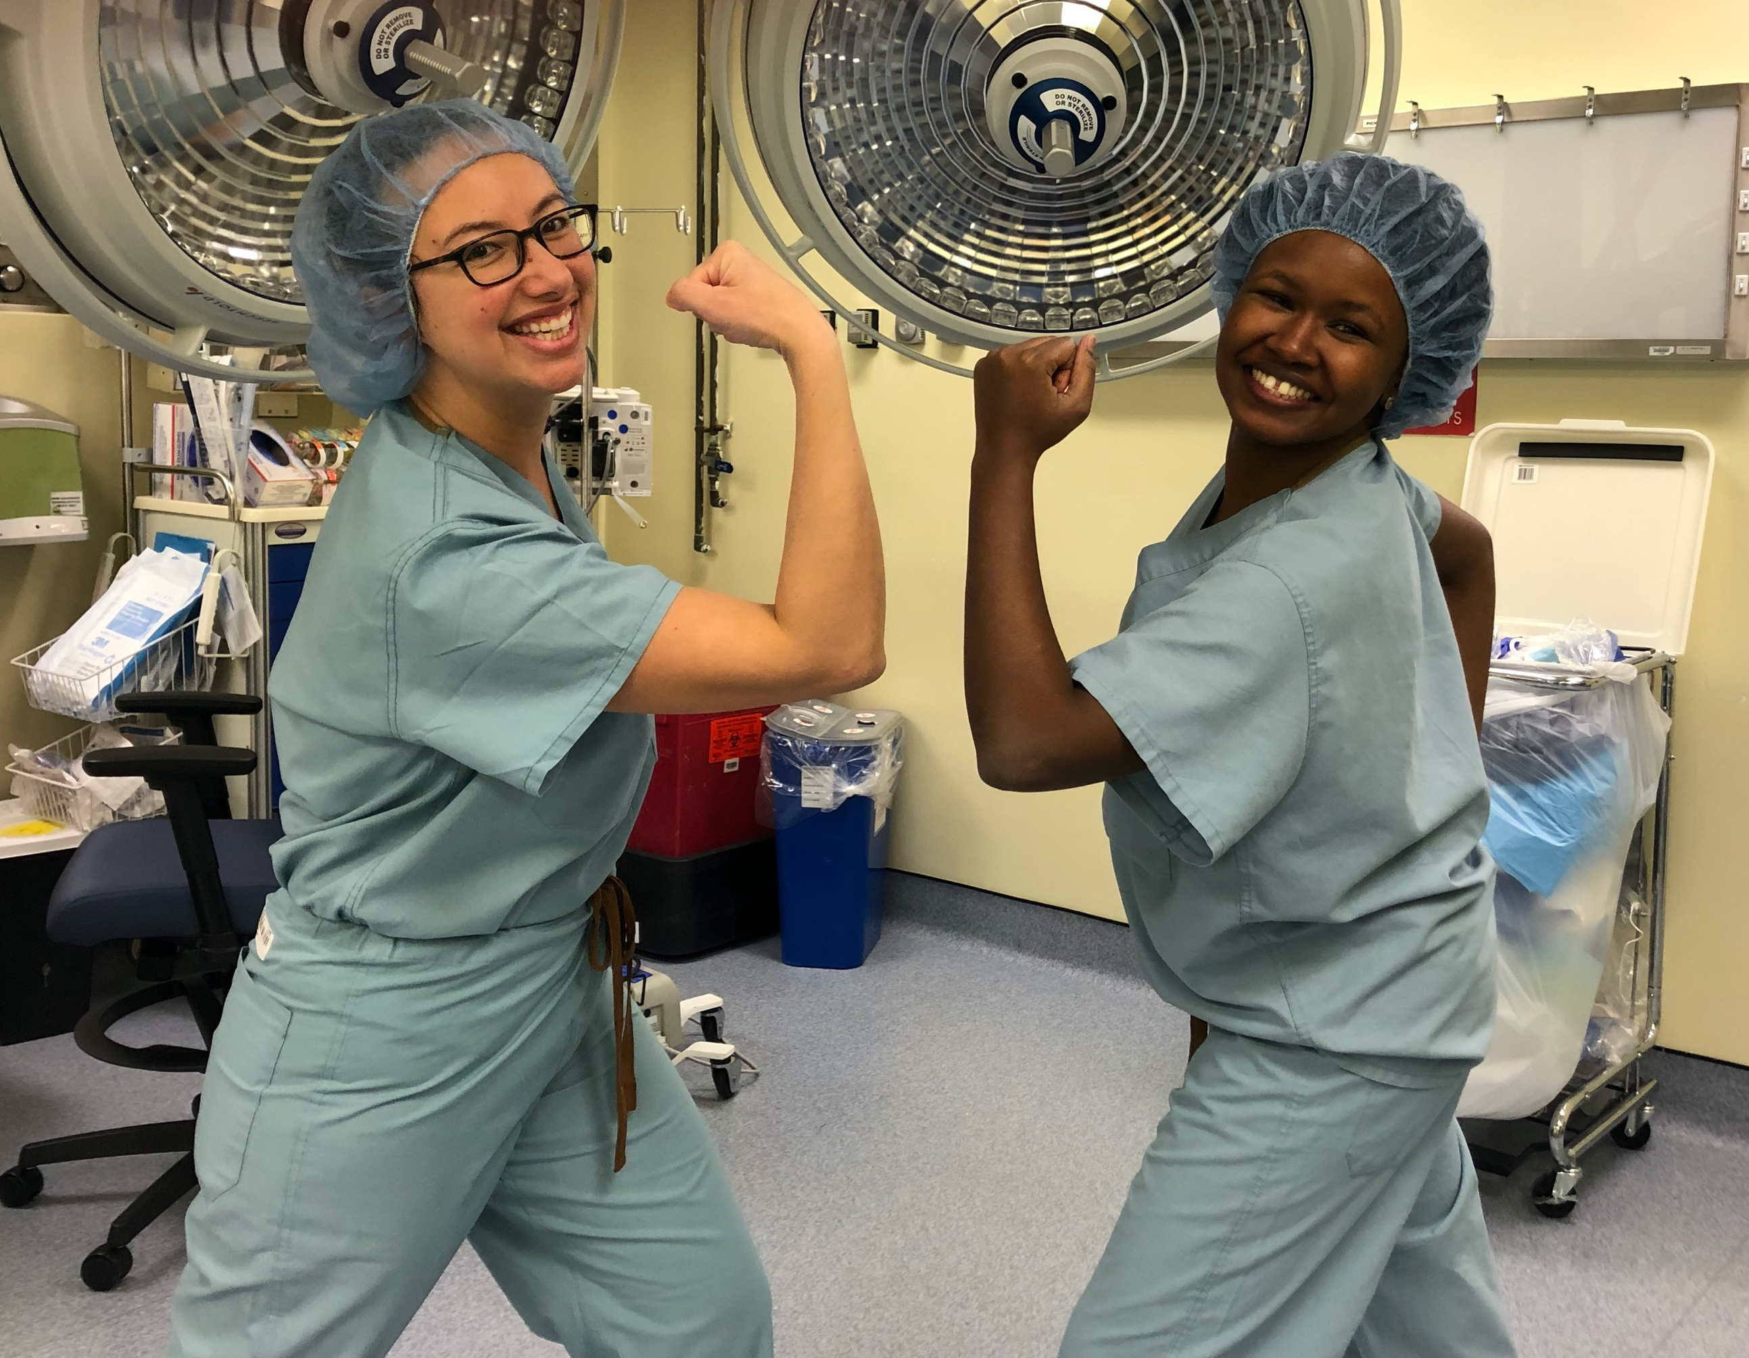
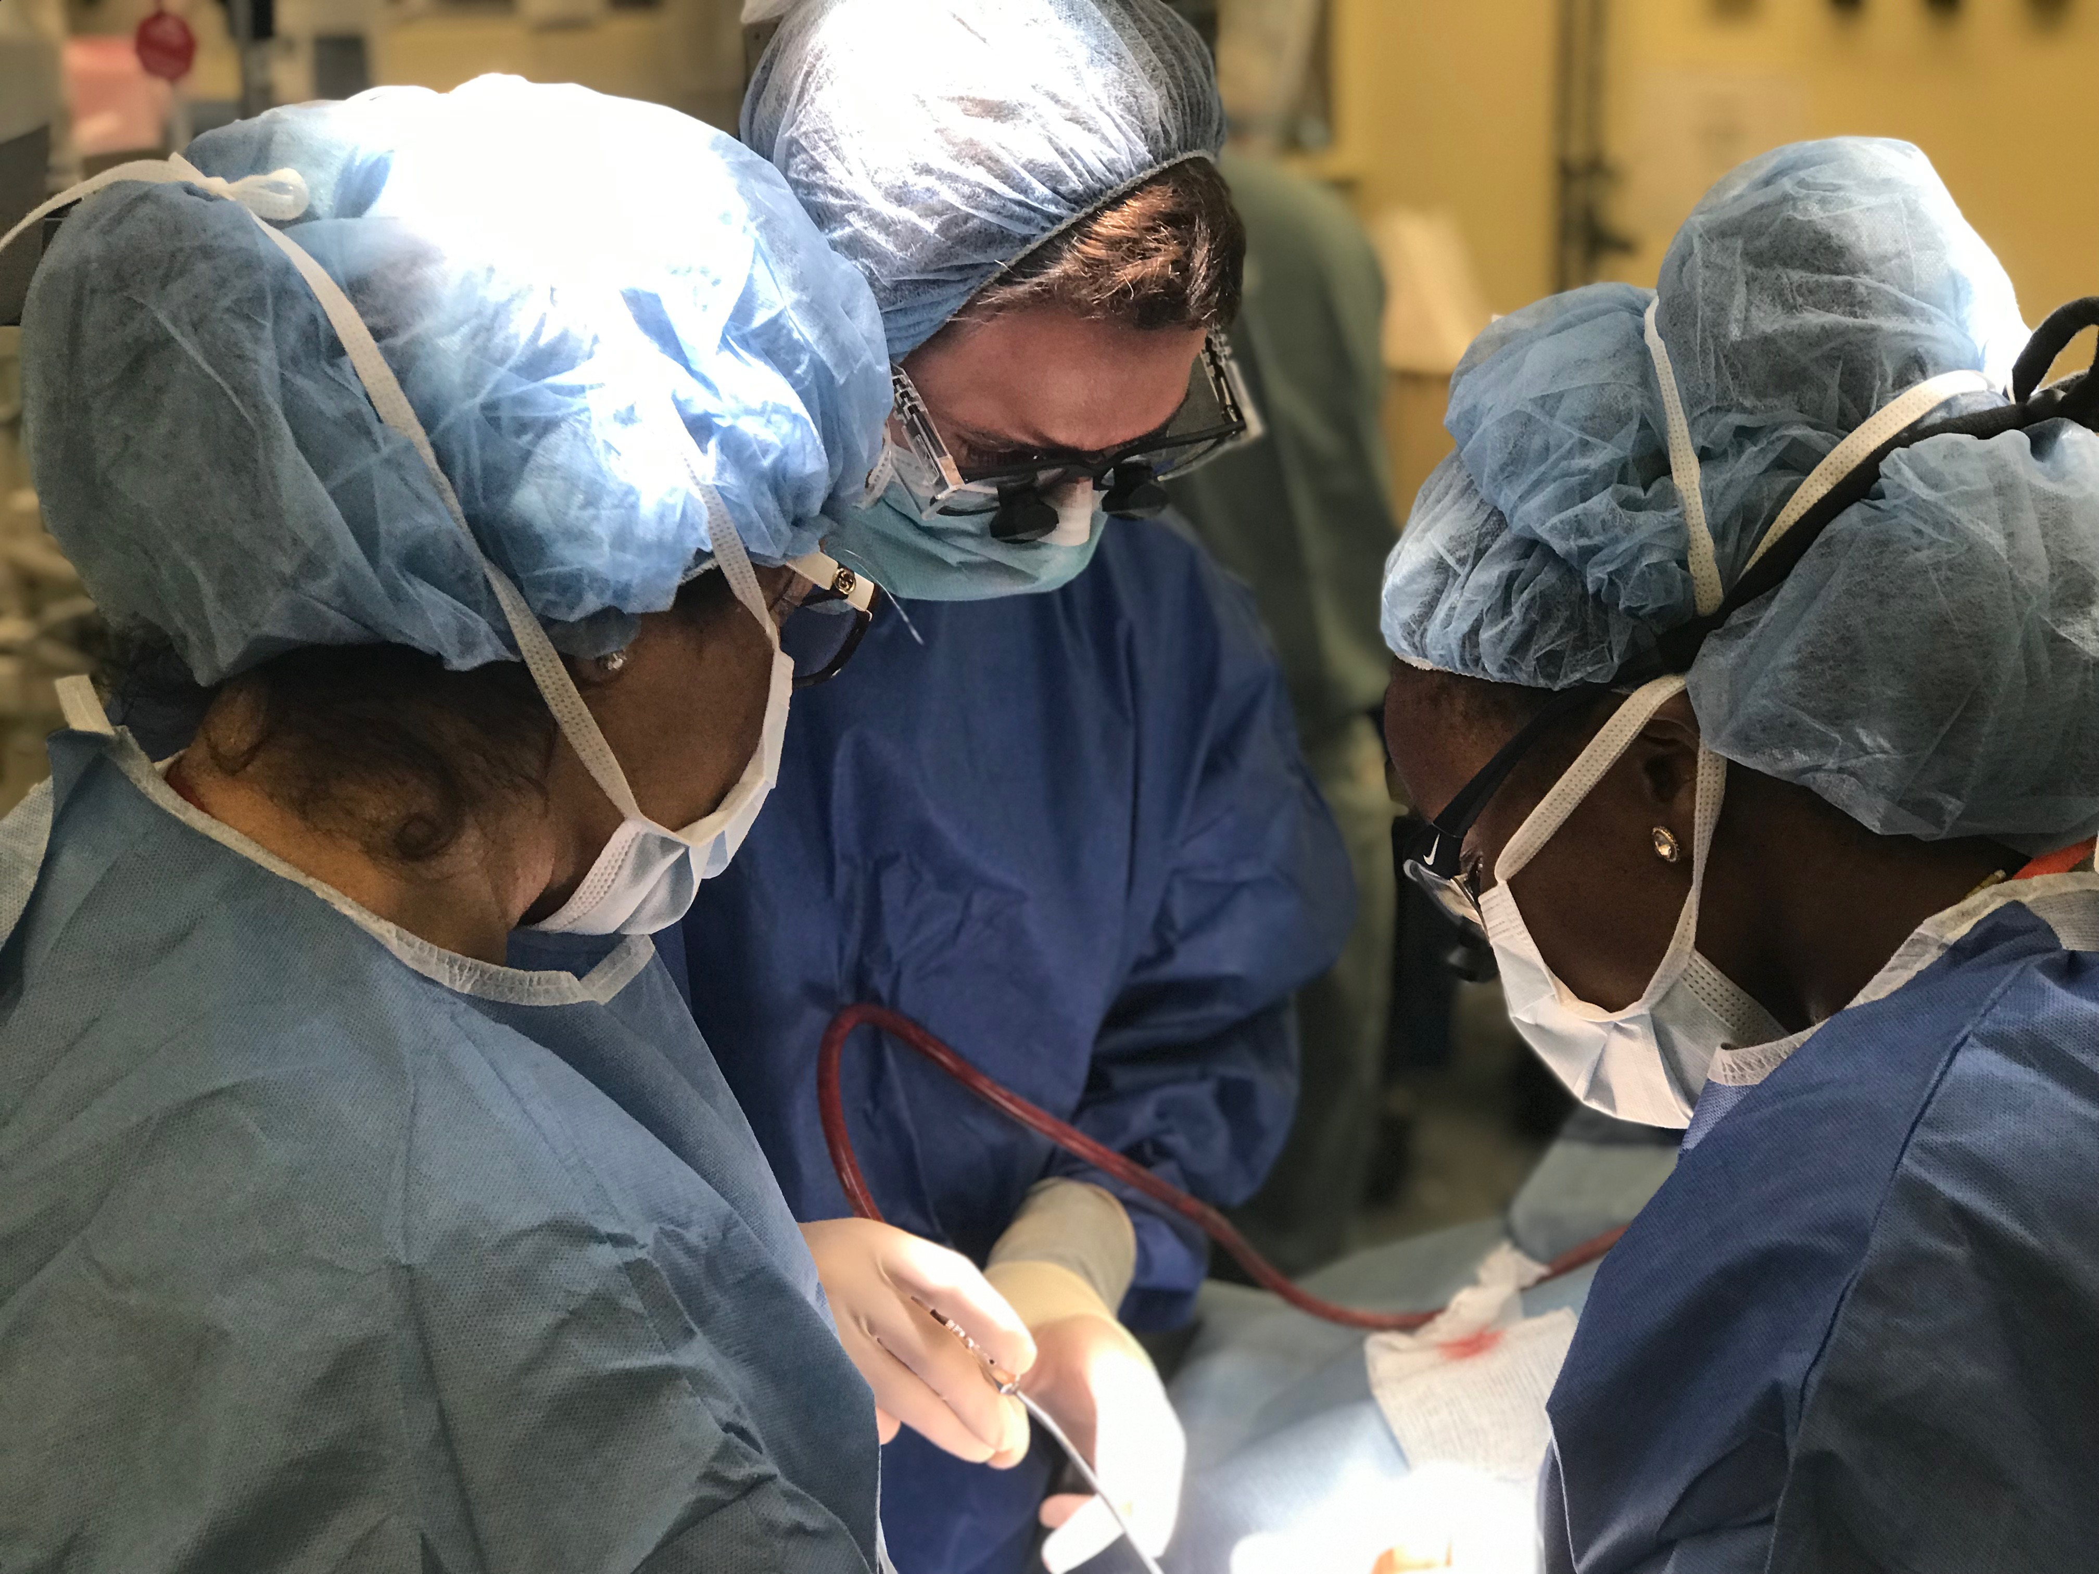
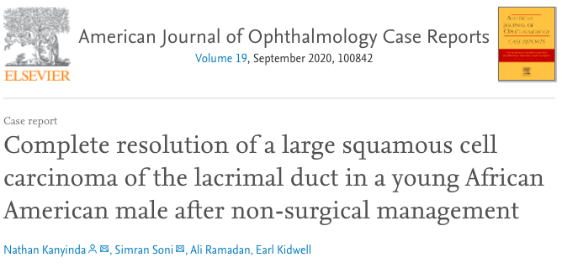
Robust Surgical Volumes and Clinical Pathology

Slide 14
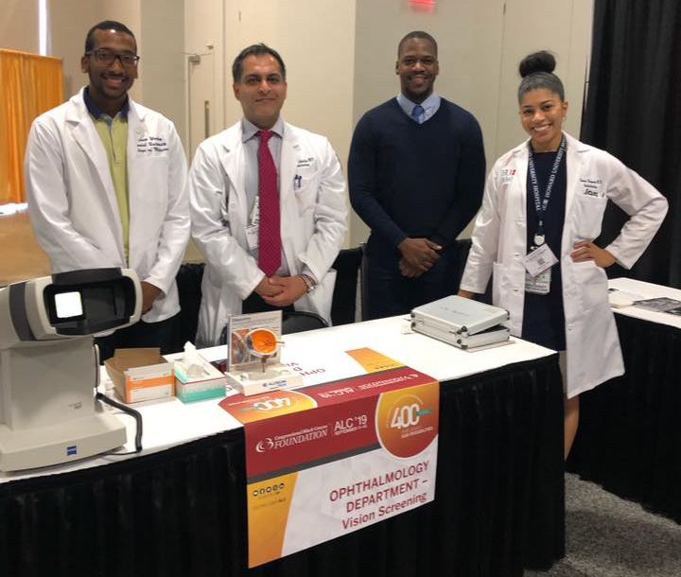
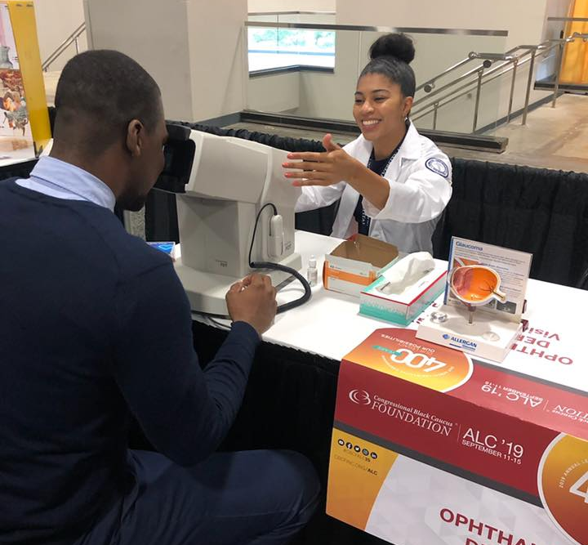
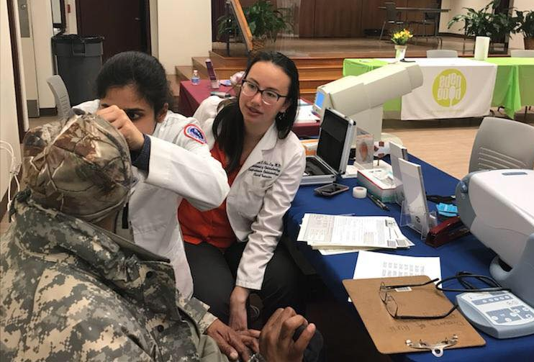
Outreach to Underserved Communities
Locally
  Partner with our medical student group, Student Sight Savers, to provide community vision and glaucoma screenings
  Visit local schools with Prevention of Blindness Society to provide vision screenings for elementary-aged children

Slide 15
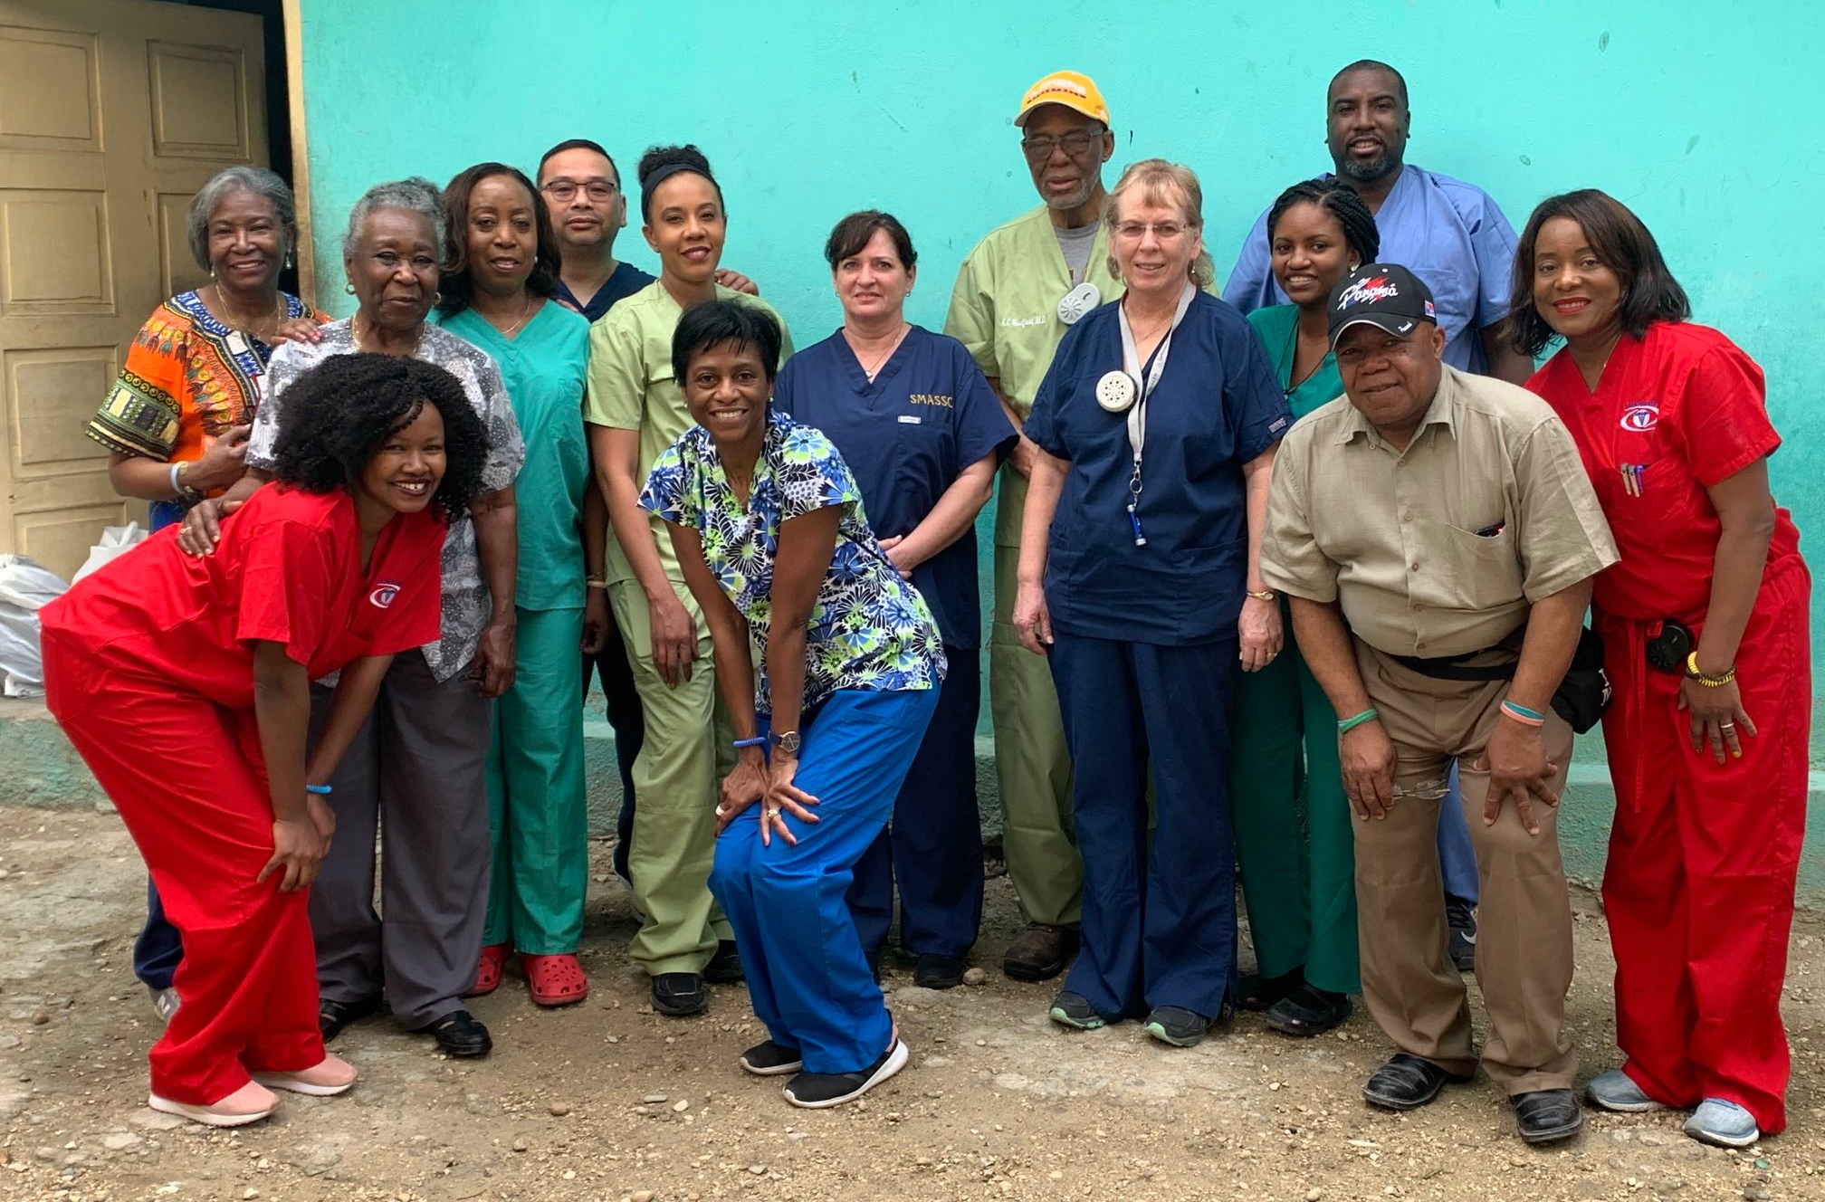
Outreach to Underserved Communities
Globally -- in the recent past, residents have been able to do outreach/mission trips to the following countries with attendings that have also traveled to such places:
  Haiti
  Ethiopia/Egypt
  Nigeria
  Ecuador
  Honduras

Slide 16
Where do our residents end up?
Class of 2017
    Mehul Patel, Comprehensive Academic, UCF
  Valerie Lerebours—Medical Retina, Orlando VA
  Erica Alvarez– Medical Retina, The Ohio State
Class of 2016
    Chinwenwa Okeagu – Uveitis, Wilmer; Medical Retina, Orlando VA; Surgical Retina, Henry Ford
  Katrina Chin Loy – Comprehensive Academic, HUH
  Usiwoma Abugo – Oculoplastics, Central Valley Eye
Class of 2015
  Chris Burris – Ocular Pathology, University of Wisconsin, Oculoplastics, USF
  Neal Desai – Comprehensive Private Practice, New York
Class of 2014
  Nikisha Richards – Oculoplastics, University of Pittsburgh
  Stephen Odaibo – Medical Retina, University of Michigan
  Saima Qureshi – Cornea, University of Minnesota
Class of 2013
  Ninita Brown – Glaucoma, Duke University
  Mona Kaleem – Glaucoma, Cleveland Clinic
  Mikelson MomPremier – Surgical Retina, University of Texas, Galveston
Class of 2012
  Salman Yousuf – Medical Retina, Orlando VA
  Gawain Dyer – Surgical Retina, University of Missouri
  Animesh Petkar – Surgical Retina, Vitreoretinal Foundation, Memphis TN
Class of 2022
  Ali Allahdina – Glaucoma, University of Illinois
  Simone Ferguson – Comprehensive Private Practice, Detroit, MI
  Rodney Guiseppi – Surgical Retina, University of Texas Galveston
Class of 2021
  Asima Bajwa – Glaucoma, Yale
  Elizabeth Wanja Mathenge – Global Ophthalmology, Stanford
  Clarke Nelson – Comprehensive Private Practive, Baltimore, MD
Class of 2020
  Nathan Kanyinda – Oculoplastics, University of New Mexico
  Arlen Brent Richard – Comprehensive, Ochsner
  Matthew Tadrus – Comprehensive Private Practice, Access Eye, VA
Class of 2019
  Pavan Angadi – Comprehensive, VAMC Charlotte
  Cristina Lopez-Beauchamp – Glaucoma, USF
  Alexandros Pappas – Comprehensive Private Practive, Pinnacle Eye, FL
Class of 2018
    Faisal Ridha, Glaucoma, Kresge
  Shadi Davis – Oculoplastics, USF
  Nathan Abraham– Cornea, UCLA

Slide 17
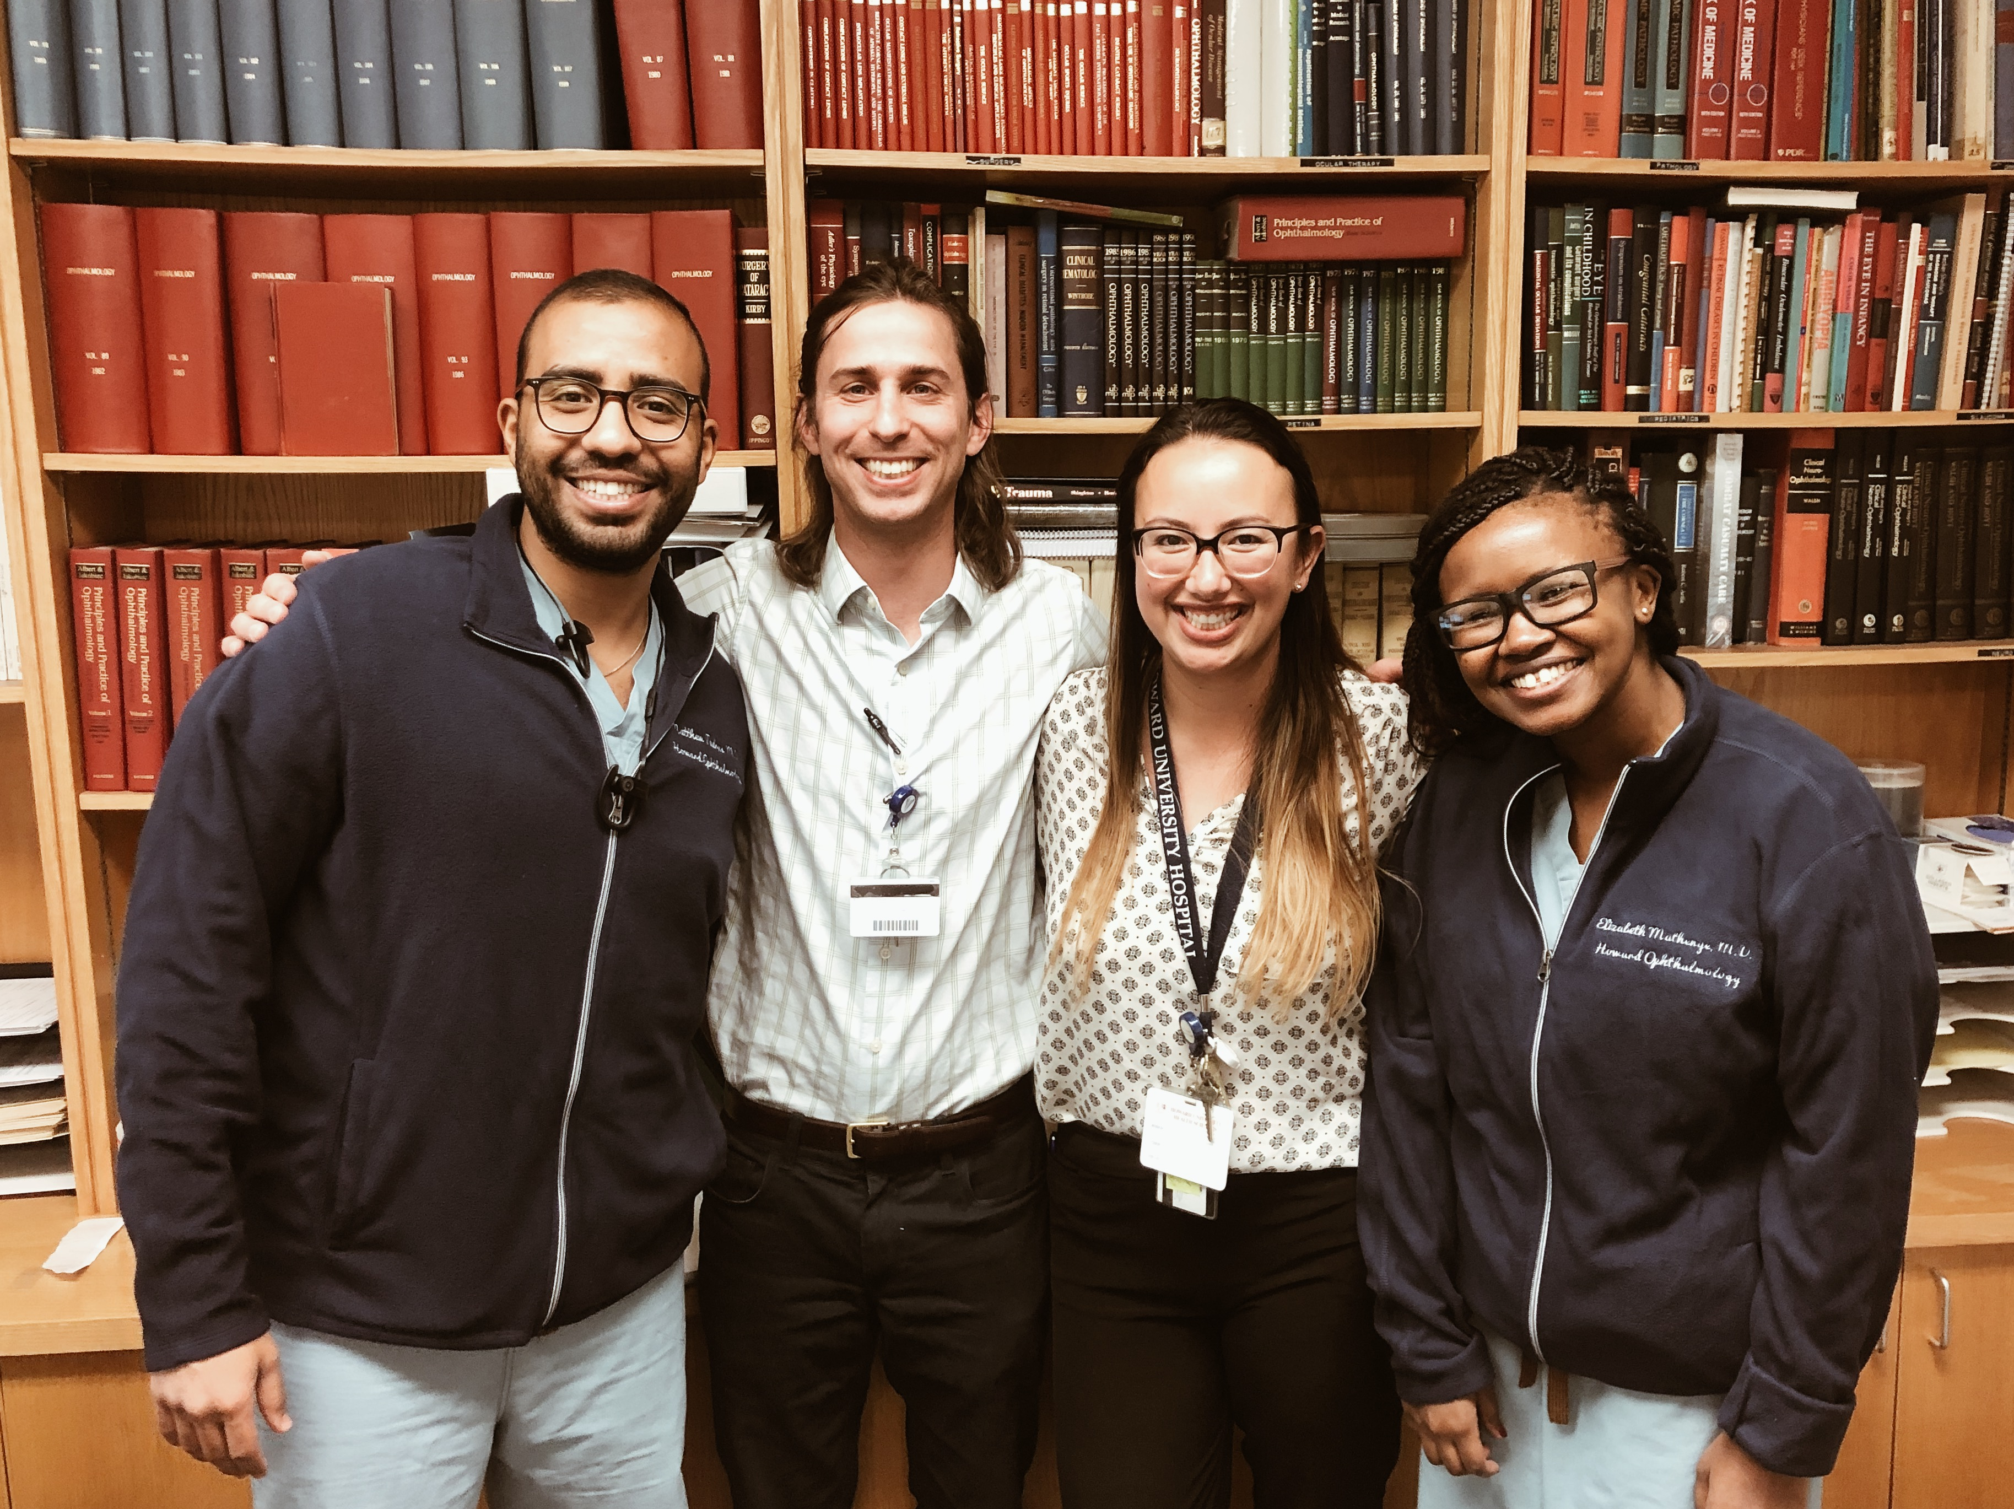
Resident Benefits
Vacation: Three weeks annually
Board review course stipend during PGY-4
Online review course available all years
Lenses and BCSC eBooks provided
Health and dental insurance
Disability, Life and Malpractice insurance
Monthly meal allowance
White coats with embroidered name
and laundry service
Educational allowance
Chief stipend
Free parking
Travel costs and housing for Orlando rotations
CIR Union
And of course….Washington, DC and Orlando, FL are great places to live…

Slide 18
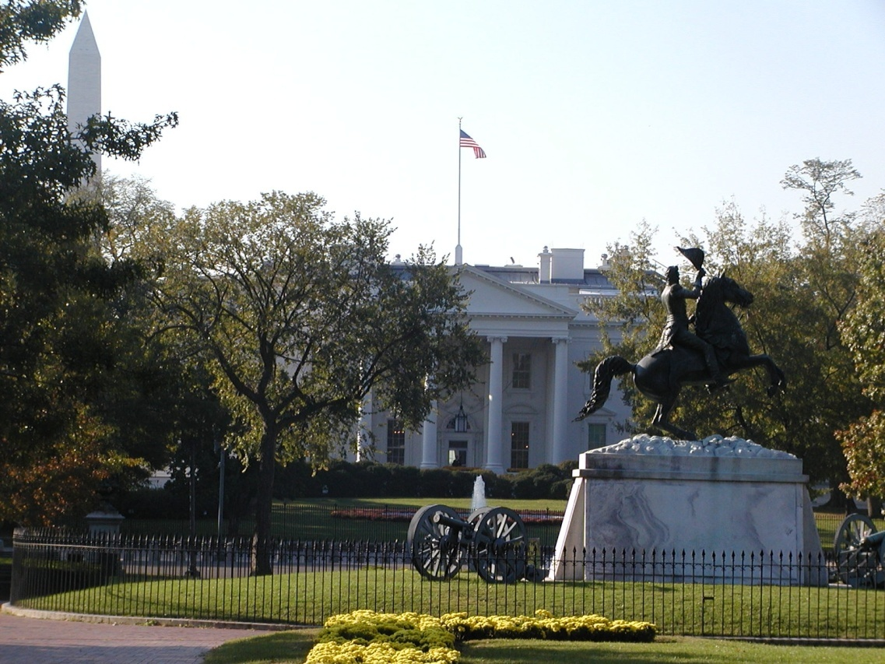
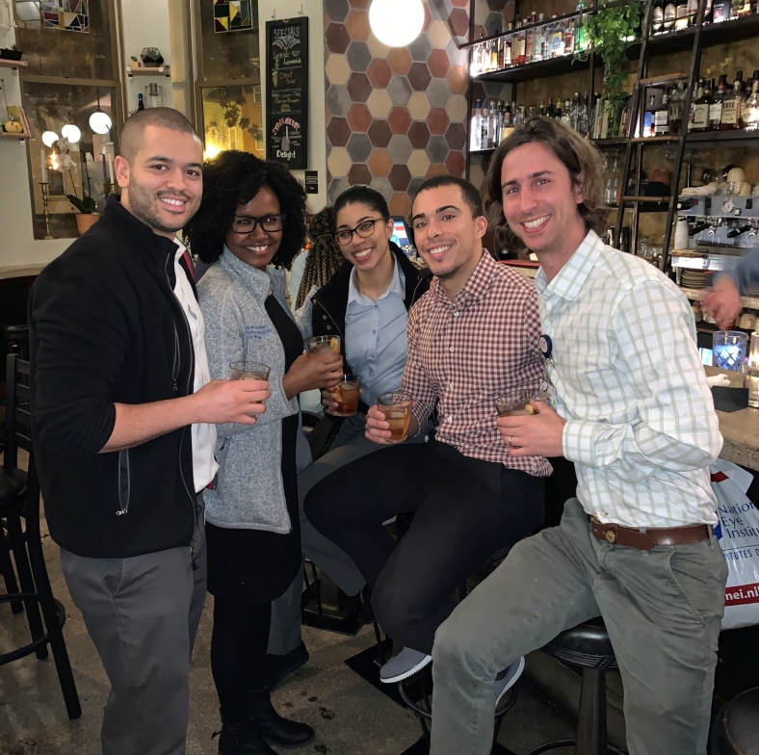

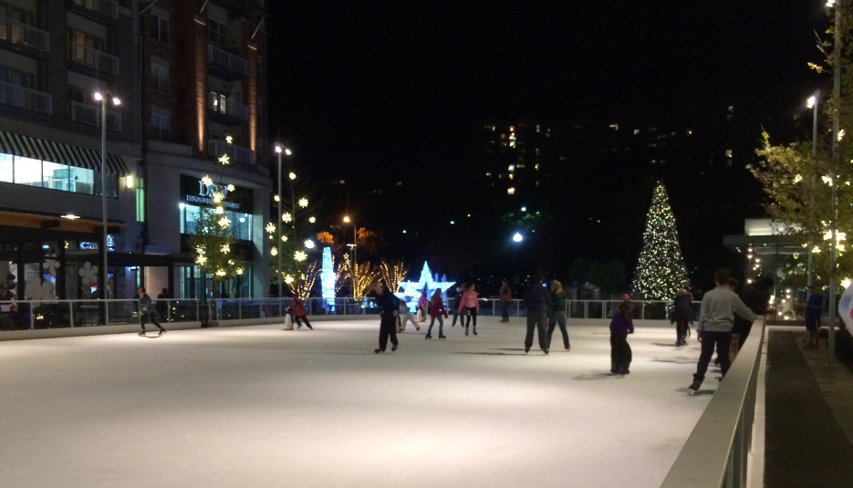
Notes:
Cherry blosson, other sports teams

Slide 19

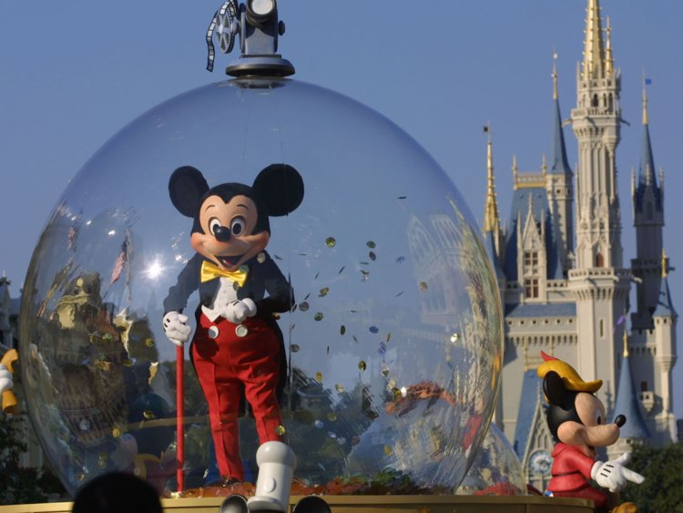
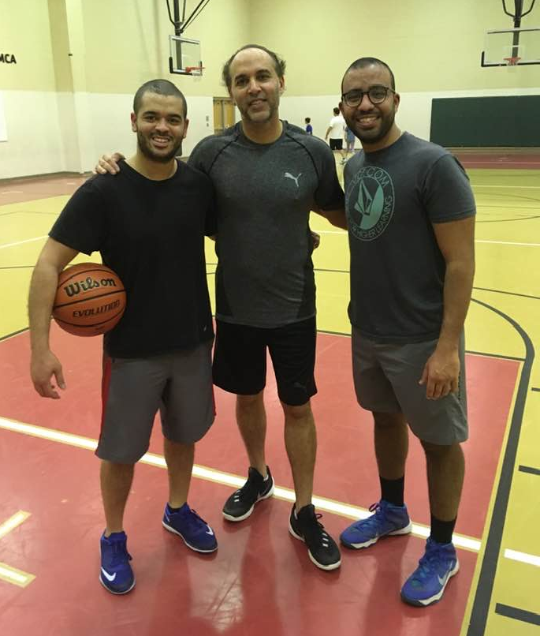


Slide 20
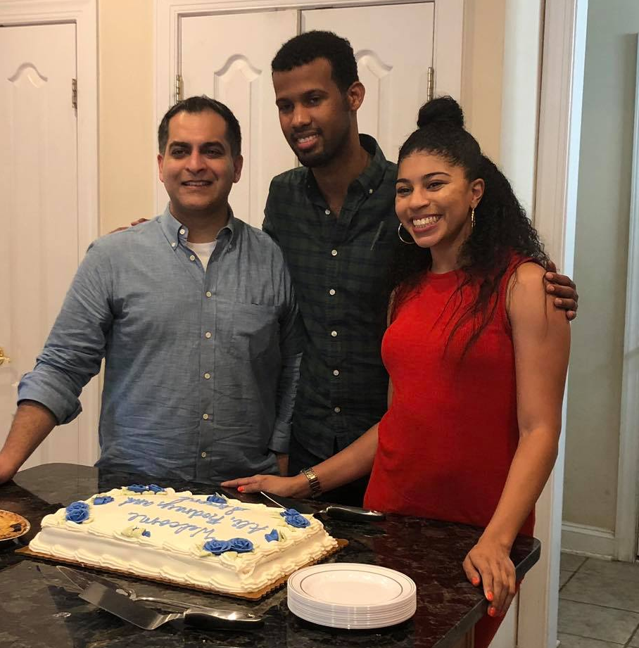
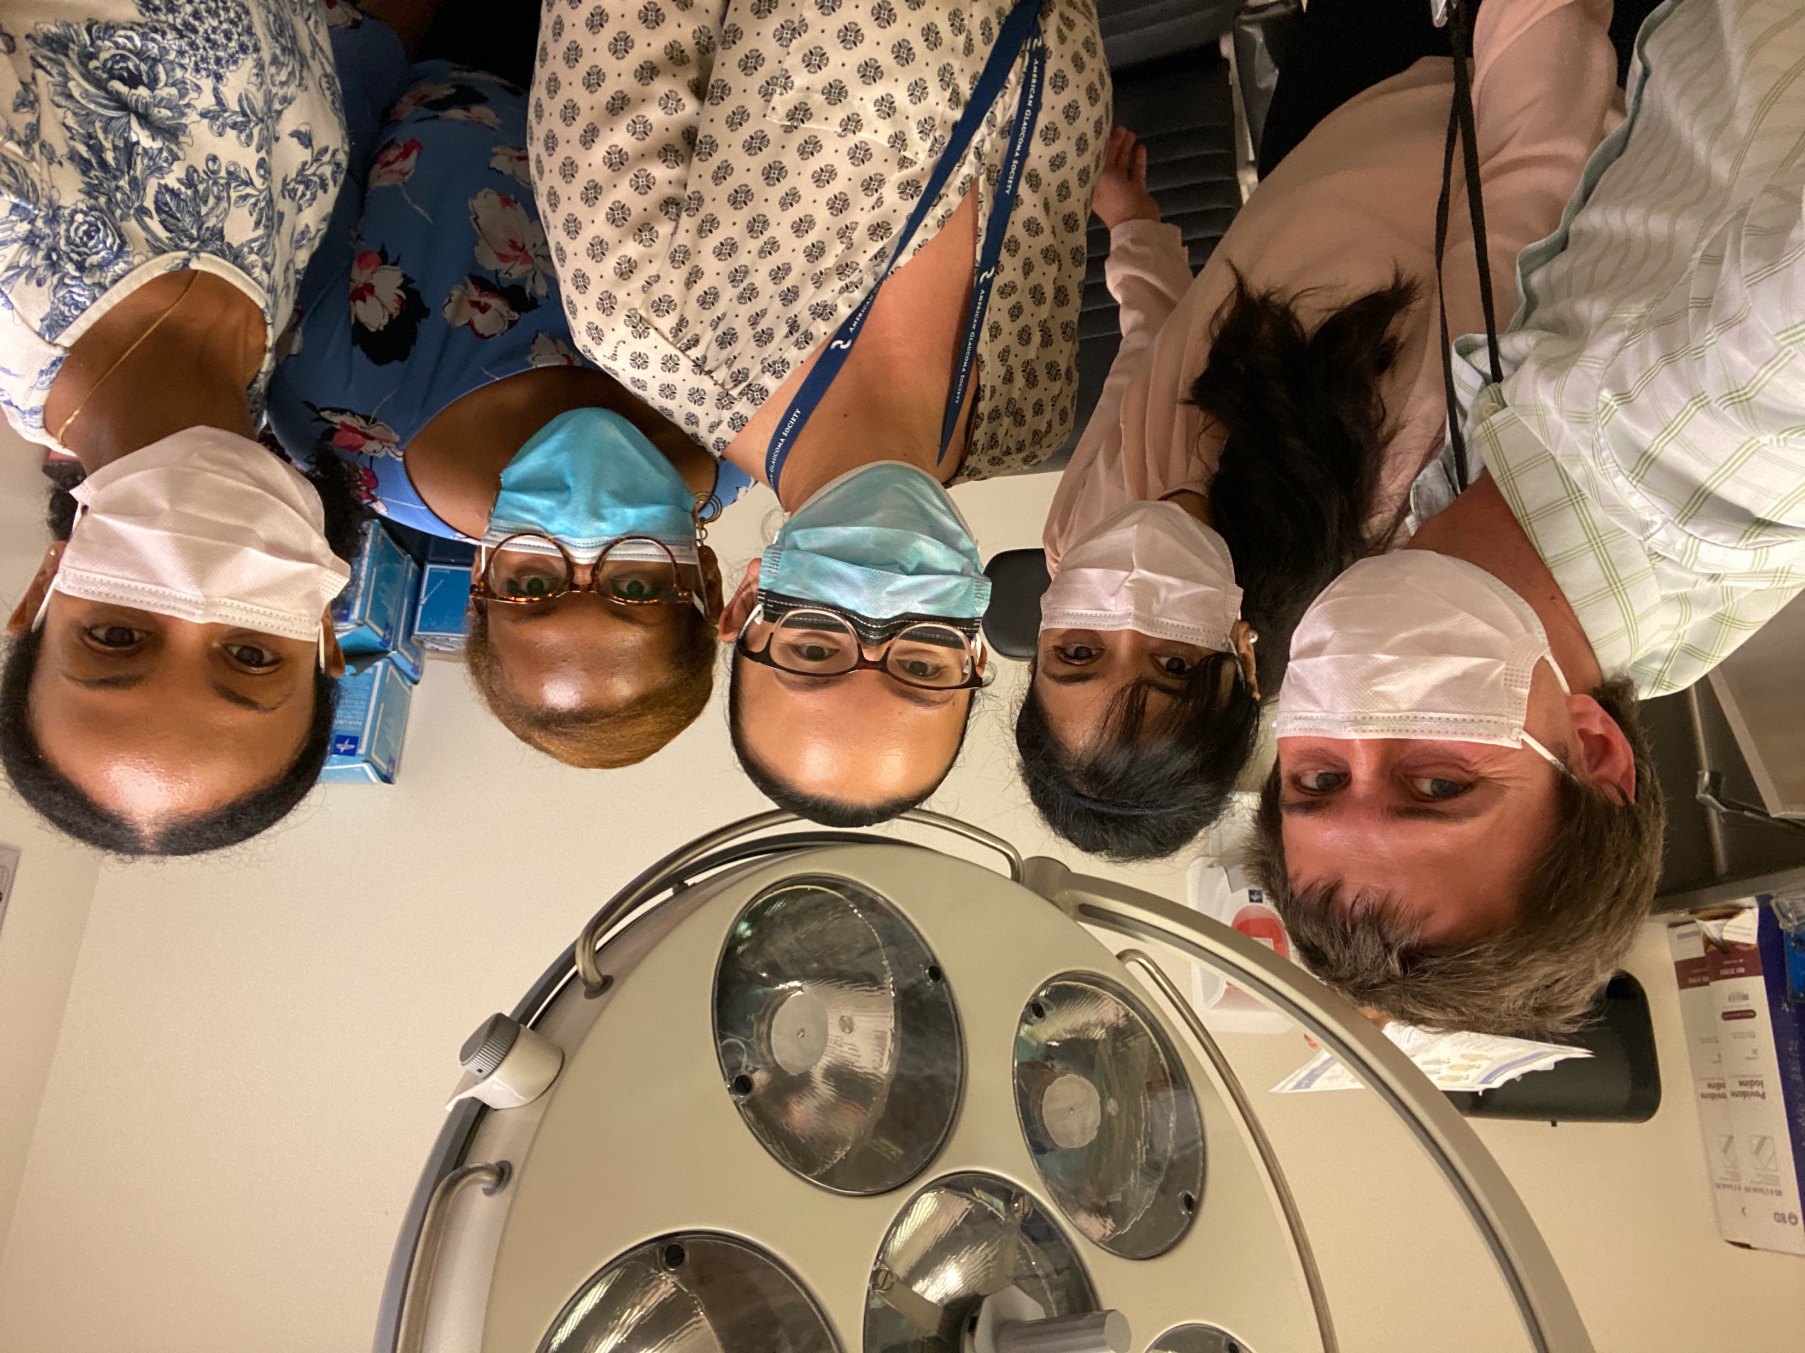
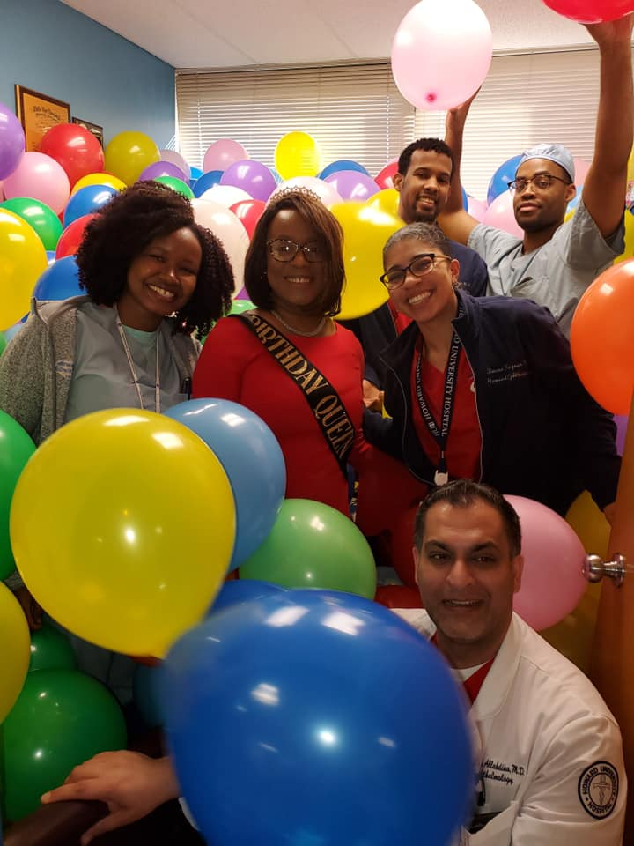
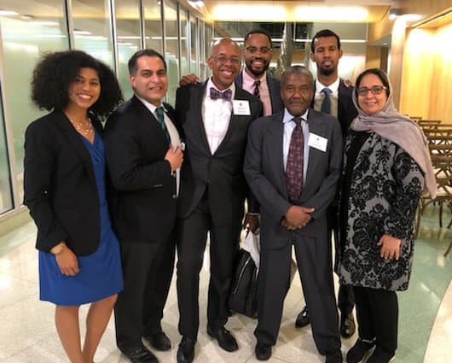
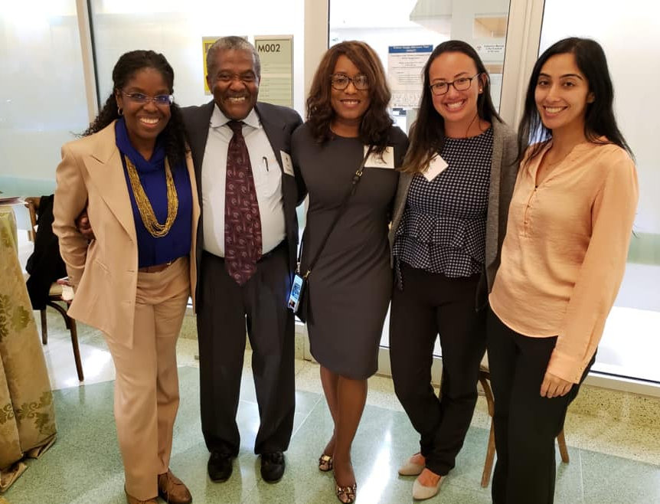
More than Ophthalmology

Slide 21
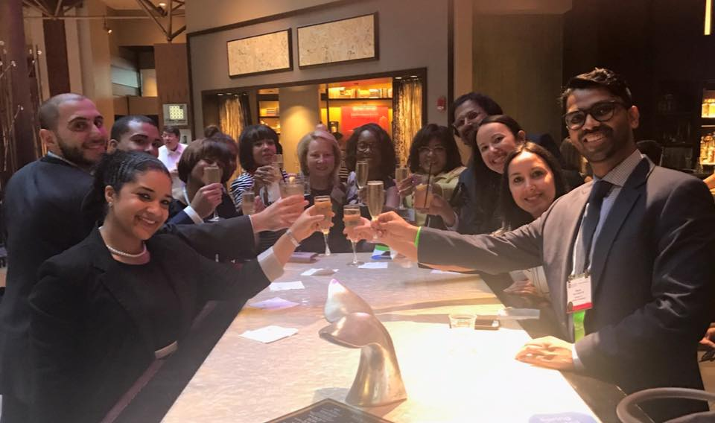
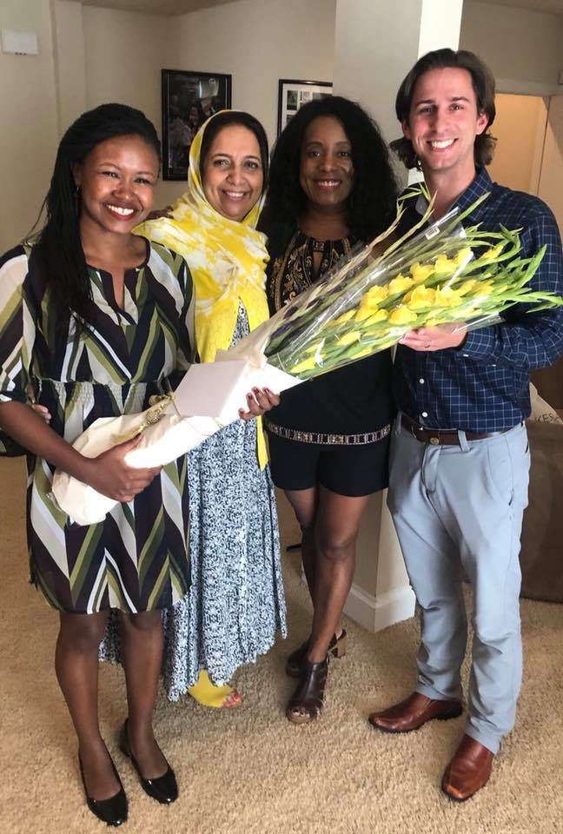
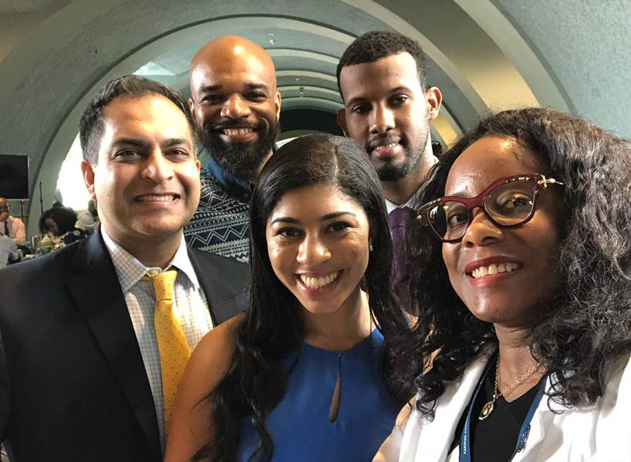
More than Ophthalmology

Slide 22
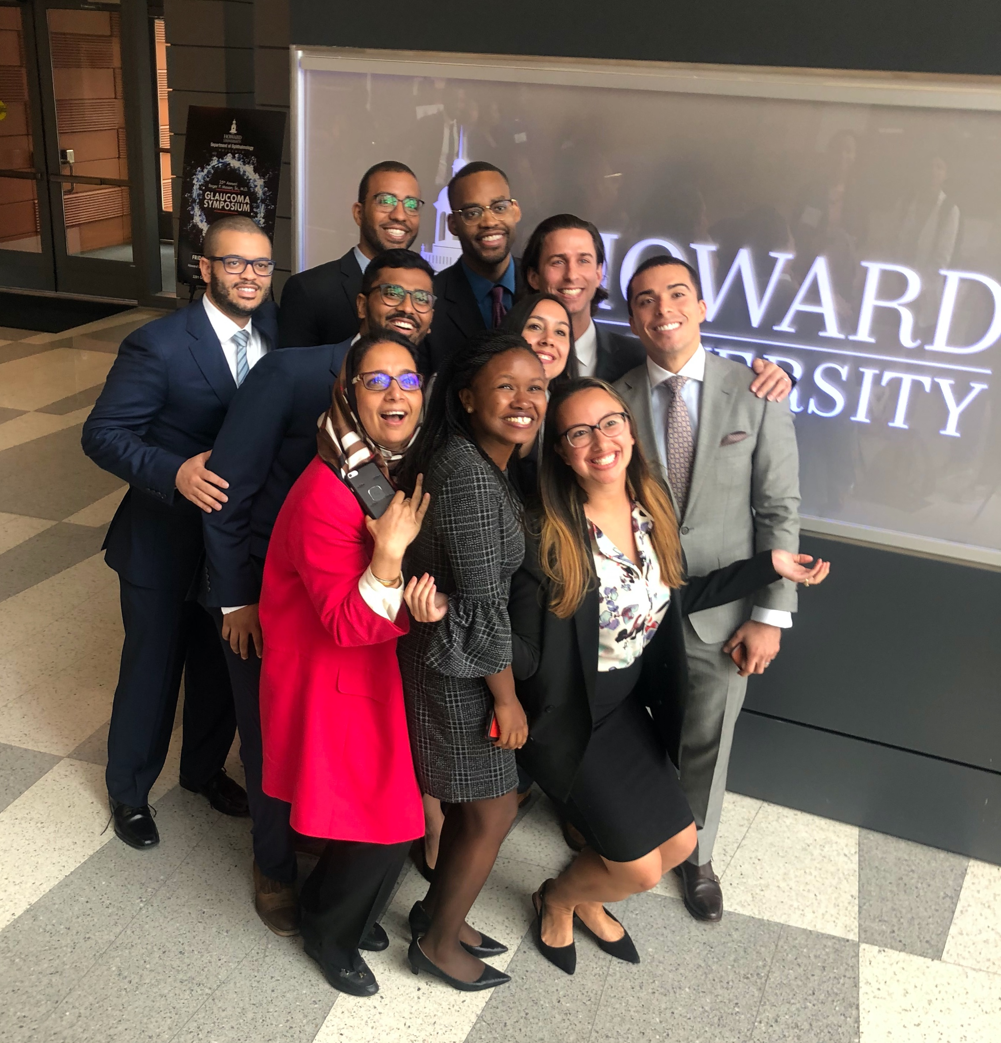

Slide 23
Contact us:
Leslie S. Jones, MD (PD/Chair) – l_s_jones@howard.edu
Belinda Collins (Coordinator) – bcollins@huhosp.org
https://medicine.howard.edu/education/graduate-medical-education-gme/residency/ophthalmology
www.howardophthointerview.com

